Slide 1

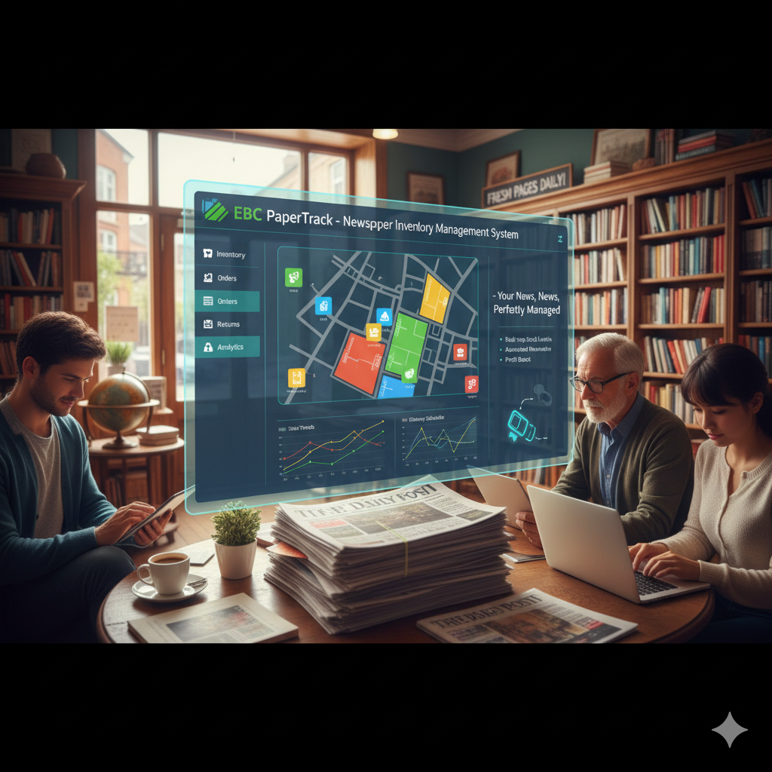
EBC PaperTrack Newspaper Inventory Management System
Group 3

Slide 2




Team
E.M. Virani S. Ekanayake (FGS/MIT/2024/081)
G. Shasitha Madushanka Gamlath (FGS/MIT/2024/068)
M.G.R.P. Yasasiri
(FGS/MIT/2024/009)
S.A.I.A. Subhasinghe (FGS/MIT/2024/073)

Slide 3

List of Overview
01.
Introduction & Problem Statement
04.
UML Diagrams
02.
Project Objectives
05.
Feature Showcase
03.
Technology Stacks
06.
Future Improvements

Slide 4
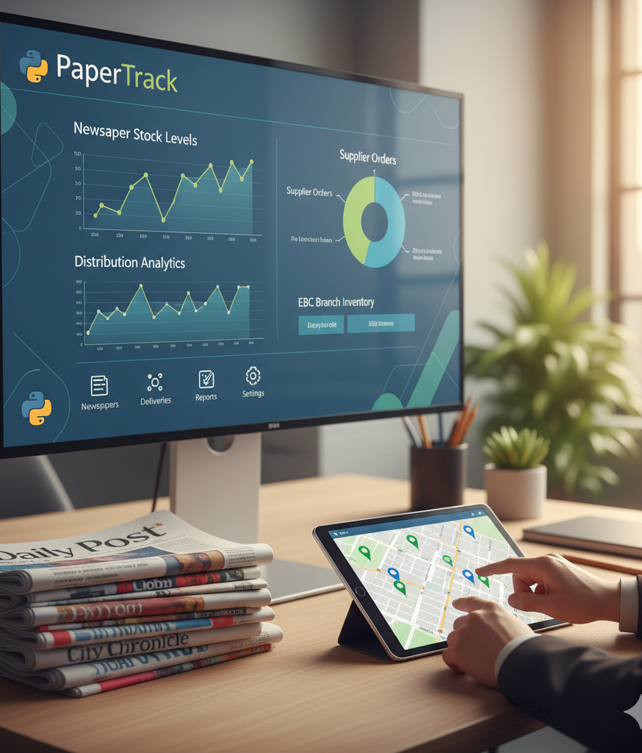
Introduction & Problem Statement
Client: Ekanayake Book City (EBC), Polpithigama.
The Problem:
The existing system for managing stock, processing orders, and handling advertisements is entirely manual.
This manual process is time-consuming and leads to a high rate of human error.
The Solution:
EBC-PaperTrack, a standalone desktop application developed in Python, designed to automate and streamline EBC's core operations

Slide 5
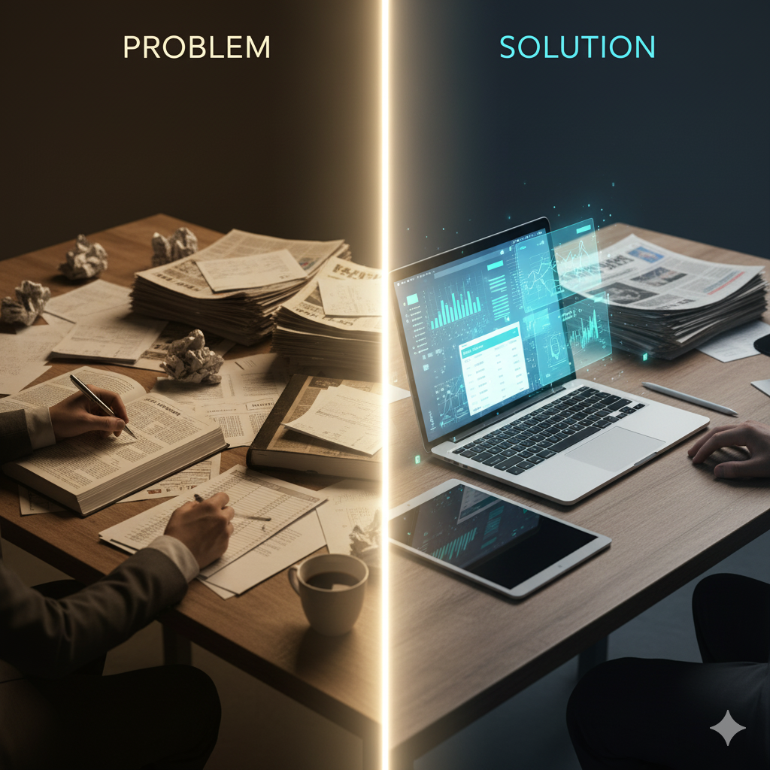



Project Objectives
Stock Management:
Maintain updated stock levels of newspapers and magazines.
Order Processing:
Accept and prepare customer orders for publications.
Customer Management:
Maintain a database of all customers and their details.
Advertisement Handling:
Manage the placement of newspaper advertisements.
Billing & Invoicing:
Automatically generate monthly bills for customers.
The primary goal is to develop a system that assists EBC in managing its daily operations efficiently.

Slide 6
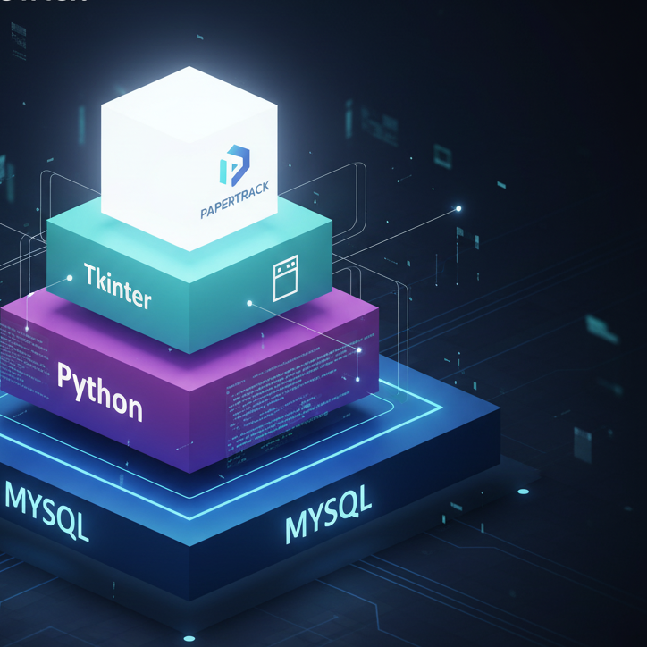
Technology Stack
Programming Language: Python
Graphical User Interface (GUI): Tkinter, a built-in Python library
Database: MySQL, an open-source relational database
Diagram Design: Draw.io
Collaboration Tools: Google Docs, Zoom
Version Control System : GitHub

Slide 7
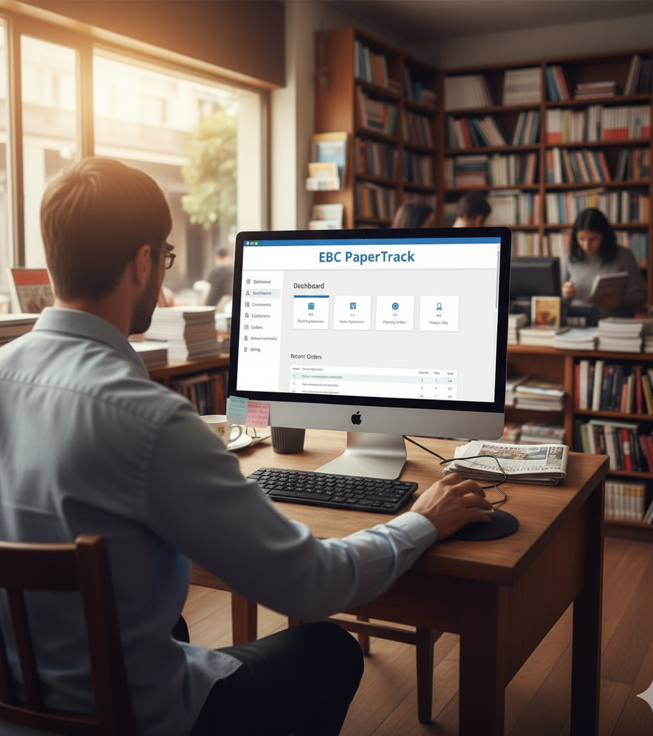
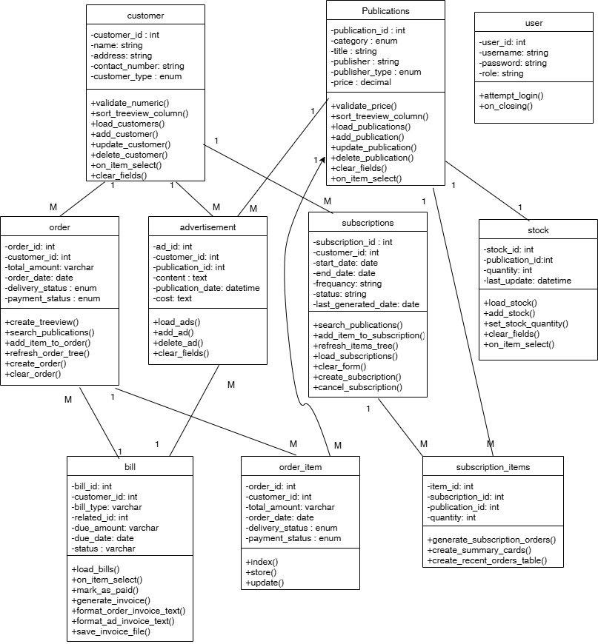
Class Diagram - Blueprint in object-oriented modelling

Slide 8
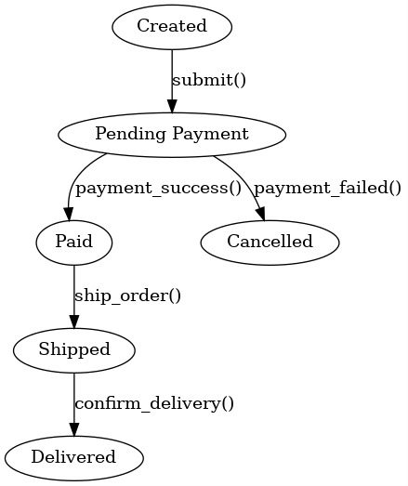
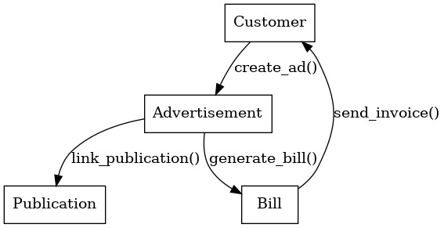
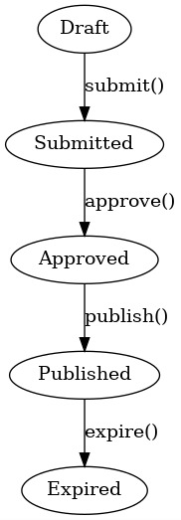
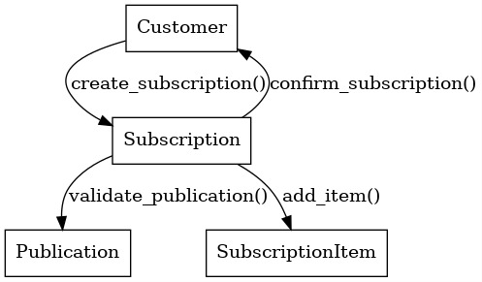
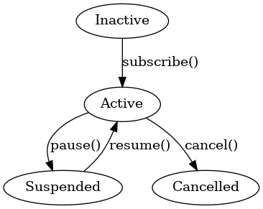
Other Diagrams
State Diagrams
Sequence Diagrams

Slide 9

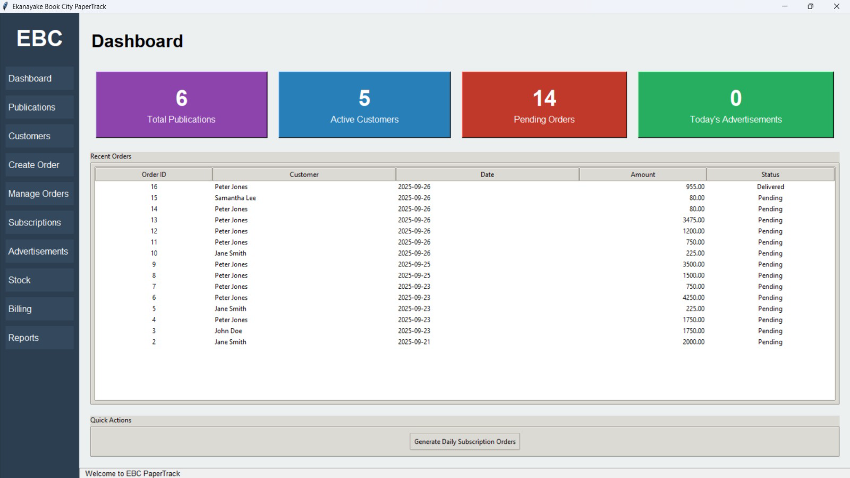
Feature Showcase: Dashboard
The dashboard serves as the landing page, offering a quick overview of the business status.

Slide 10
Feature Showcase:
Customer & Publication Management
Customer Management (customers_page.py):
Add, update, and delete customer records.
Fields include Name, Address, Contact Number, and Type (Daily/Weekly/Monthly).
A selectable list displays all customers in the database.
Publication Management (publications_page.py):
Add, update, and delete newspapers and magazines.
Details include Category, Title, Publisher, Type (Daily, Weekly, etc.), and Price.

Slide 11
Feature Showcase:
Stock Management
This module provides a direct way to manage inventory levels.
Stock Management (stock_page.py):
View Current Stock: Displays a comprehensive list of all publications along with their current quantity and the last updated timestamp.
Update Stock: Users can select a publication and enter a new quantity to update the inventory level in the database.
Integrated Data: The publication dropdown is populated directly from the publications table, ensuring data consistency

Slide 12
Feature Showcase:
Order Processing
A powerful interface designed to make the order creation process fast and accurate.
Order Creation (orders_page.py):
Select Customer: Choose an existing customer from a dropdown list.
Search Publications: Search for publications by name to find items quickly.
Add Items to Order: Select a publication from the search results, specify a quantity, and add it to the current order basket.
Live Calculation: The system displays all items in the current order and automatically calculates the running total amount.
Finalize Order: Create the final order, which is then saved to the database along with its associated items.

Slide 13
Feature Showcase:
Advertisement & Billing Management
Advertisement Handling (advertisements_page.py)
Select customer and publication, enter ad content.
System auto-calculates cost by word count and asks for confirmation before saving.
Billing Management (billing_page.py)
Lists all bills (orders + ads) with customer, amount, due date, and status.
Users can mark unpaid bills as paid, updating the database.

Slide 14

Future Improvements
Mobile Accessibility: Dedicated mobile application for remote access
01
Enhanced Notifications: Email notifications and SMS alerts for critical updates and reminders.
02
Automated Payments: Credit card auto-subscription for seamless recurring payments
03
Multi-User Support: Enhance the system to be installed and used on multiple PCs within EBC
04

Slide 15

Thank You
Any Questions..?

